Slide 1
Clause Detection, Category-Level Risk Prioritization
and Plain-Language Explanation on CUAD
What we built, where every part of it breaks, and what we would do next
Jerin Aktar 22101279 Afnan Mazumdar 24141229 Shoyeb Hasan Sayem 22101386
Supervisor: Utsha Kumar Roy · Department of CSE, BRAC University
Notes:
Most of what we report is negative. We present the failures as the contribution.

Slide 2
CHAPTER 1
The problem
Contracts are long; the clauses that matter are short
33,000
16×
196
41
median characters
longer than a transformer window
median clause, characters
clause categories
What CUAD gives you
What we tried to add
510 expert-annotated contracts. Given a category, find the clause text. It stops at the span — no indication of what the clause means for the signer.
A risk level per clause and a plain-English sentence. Both added layers turned out weaker than intended, and this defence is largely about how we found that out.

Slide 3
CHAPTER 4
The pipeline
Four stages — and a failure point at every boundary
Contract
1 Presence
2 Span
3 Risk
4 Explanation
raw text
33k chars
›
TF–IDF +
windowed BERT
›
DistilBERT-QA
over one window
›
fixed per-category
lookup
›
FLAN-T5
template
22.0% of clauses
lost here
56.3% of clauses
lost here
0% — lookup is
correct by design
30% wrong
template
The point of this talk
Each stage was evaluated on its own and looks respectable. Assembled, only 21.7% of gold clauses survive. Component scores do not compose — and nobody had measured that.

Slide 4
CHAPTER 4
How we read a 33,000-character contract
Sliding windows, max-pooled — the multiple-instance learning rule
the clause you need — 196 chars
one contract
window 1
0.04
max = 0.91
→ category present
window 2
0.11
window 3
0.07
window 4
0.19
window 5
0.91
⋮ 22 windows for a median contract, 226 for the longest
Why this removes the recall ceiling
Why it costs precision
Windows overlap by 500 chars — more than the median clause — so no clause can fall between two windows.
One spurious window anywhere flips the whole contract to positive. Long contracts are structurally more likely to false-positive.

Slide 5
CHAPTER 5
Training three models on one laptop
Apple M4, 16 GB unified memory, Metal backend — no CUDA at any point
1
Presence
2
Span
3
Explanation
DistilBERT-base
DistilBERT-QA
FLAN-T5-small
24,000 of 53,662 windows
2 epochs · batch 16 · LR 2e-5
256 tokens · MPS
8,000 of 11,156 examples
2 epochs · batch 16 · LR 3e-5
320 tokens · MPS
4,000 of 11,156 pairs
2 epochs · batch 8 · LR 3e-4
256 in / 48 out · CPU
≈49 min
≈23 min
≈8 min
What the laptop cost us
What we recovered afterwards
Backbones downsized: DeBERTa-v3 produced NaN gradients on MPS, and MPS memory never released between runs, so the summarizer trained on CPU. Absolute scores understate what the same method would reach on CUDA.
The full-data control run kept its gradient-norm trace: median 4.66, and 98.4% of steps exceed the clipping threshold of 1.0. Clipping is active on nearly every step, not a rare safety net.

Slide 6
CHAPTER 5
What was held out during training
An examiner is entitled to ask whether the test set leaked into our choices
Model
Validation data
Used for
Presence (MIL)
5% of the TRAINING windows
monitoring only — clean
Span (QA)
none
no validation loss exists
Summarizer (deployed)
none
the checkpoint behind every reported result
Summarizer (exploratory run)
300 clauses from the TEST split
monitoring only — but the wrong data
Nothing was tuned
One thing we got wrong
Every hyperparameter is a published default. No variant was ever compared on the test set — which also means the transformer competes untuned.
The exploratory summarizer run monitored loss on test clauses. It selected no checkpoint, and the deployed model was rebuilt without it — but we should not have done it.

Slide 7
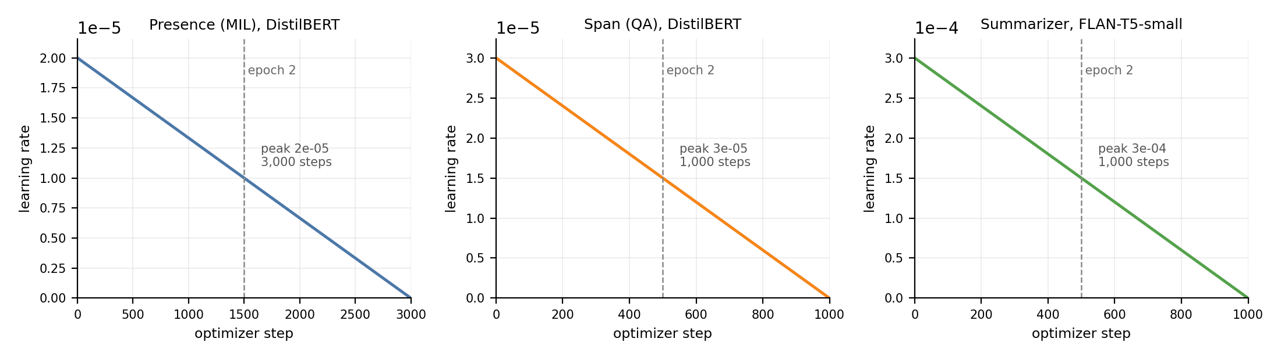
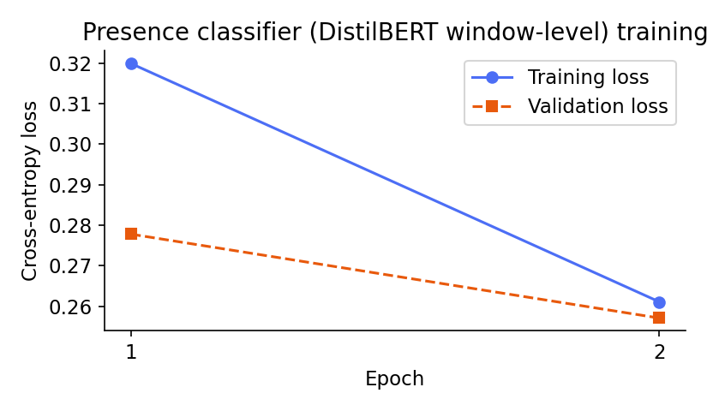
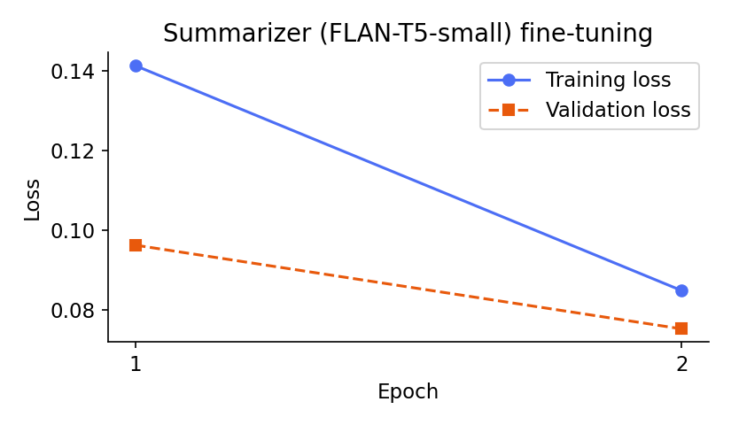
CHAPTER 5
What the training runs actually looked like
Smooth curves — which is exactly why the gradient-norm trace mattered
Learning-rate schedule for all three runs: linear decay, no warmup (Fig. 5.1)
Presence: 0.320 → 0.261 train,
0.278 → 0.257 validation
Summarizer: collapsed fast —
the first hint of template memorization

Slide 8
CHAPTER 6
How we test
The same 102 unseen contracts for every model, every number regenerable from disk
102
4,182
2,667
150
held-out contracts, never trained on
presence decisions scored
answer-bearing windows for span
clauses for the summarizer
Why we resample CONTRACTS, not decisions
Three sources of uncertainty, all measured
41 of the 4,182 decisions come from the same contract and move together. Resampling cells would give intervals roughly half as wide as the truth.
Bootstrap over contracts (10,000 resamples), model-seed SD over 3 runs, dataset-split SD over 20 refits of the baseline.
Regenerable, not retyped
And checked mechanically
A standalone notebook rebuilds every table from saved checkpoints; artifact SHA-256 fingerprints are in the appendix.
verify_numbers.py cross-checks 84 reported figures and 17 derived comparisons against the source data. It reports zero mismatches.

Slide 9
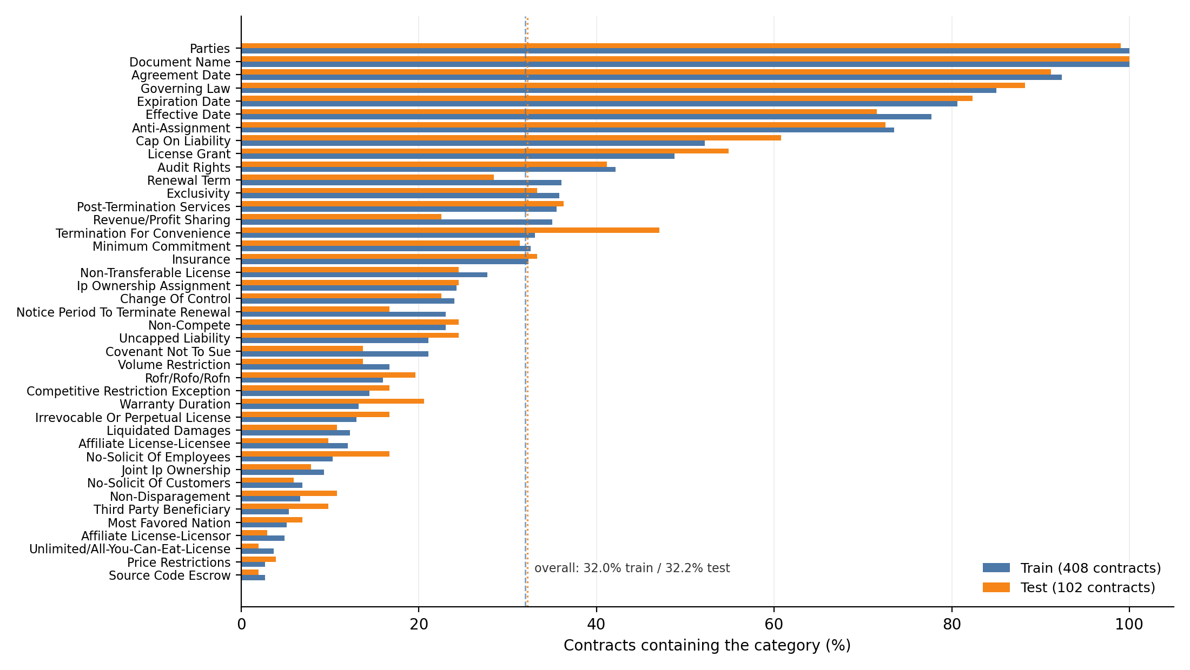
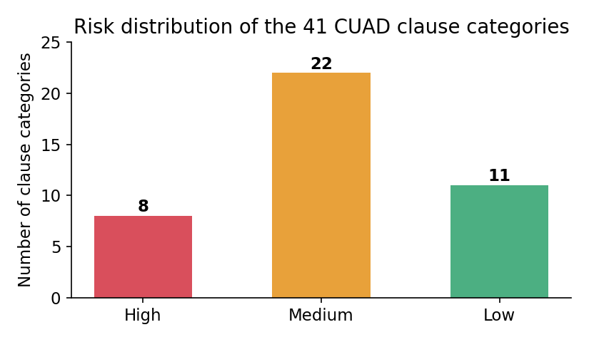
CHAPTER 3
The data we are working with
Two properties of CUAD shaped every design decision that followed
The split is balanced
Pearson r = 0.986 between the two halves, mean absolute difference 3.4 points. Drawn once at random and never re-drawn to look better.
Per-category positive rate, training vs test half of the split (Fig. 3.1 of the report)
The 41 categories across three risk levels (Fig. 4.7)

Slide 10
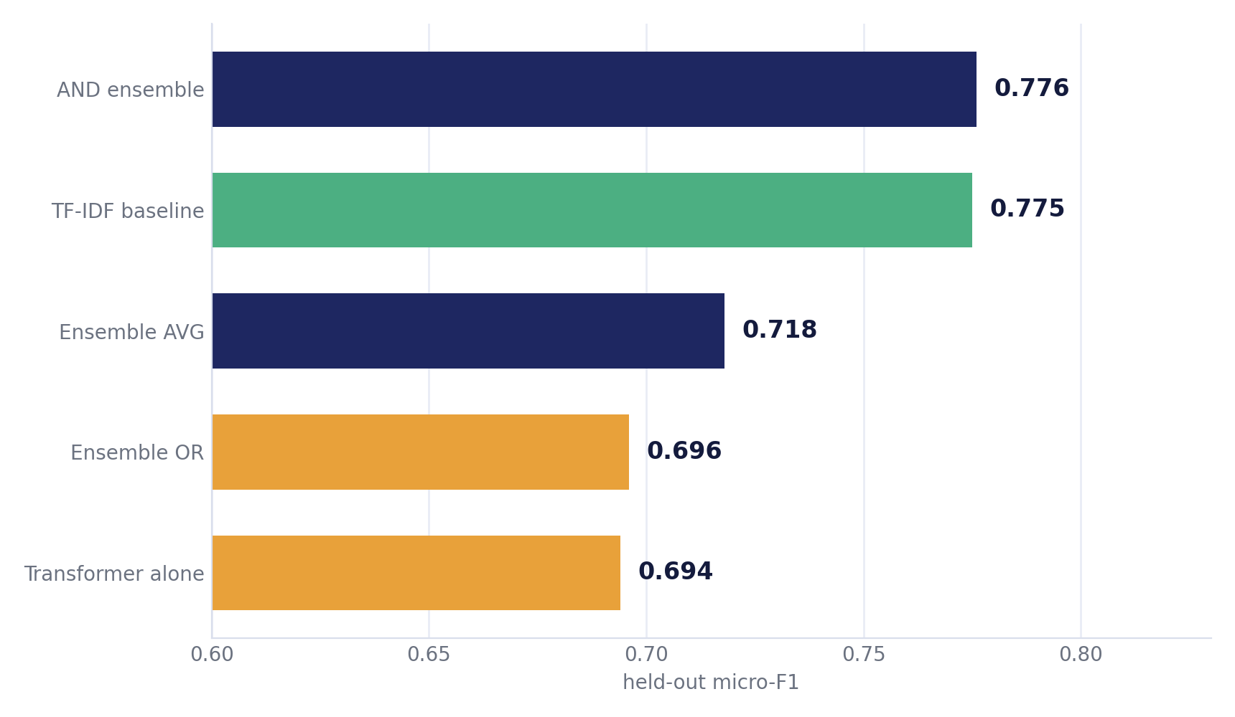
CHAPTER 6
RQ1: the transformer loses to a bag of words
Held-out micro-F1 over 4,182 (contract, category) decisions
What we stand behind
The lexical baseline beats the windowed transformer by +0.081, and it survives every control we could construct.
What we withdrew
The ensemble's +0.0014 lead is not a result. Bootstrap, seed variance and split variance all exceed it.

Slide 11
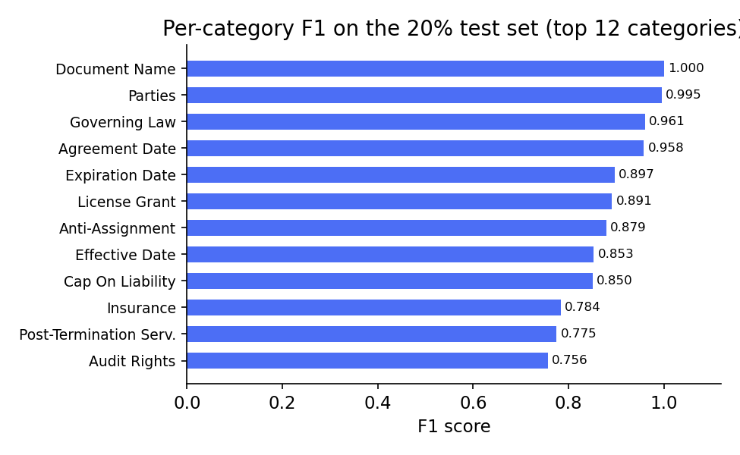
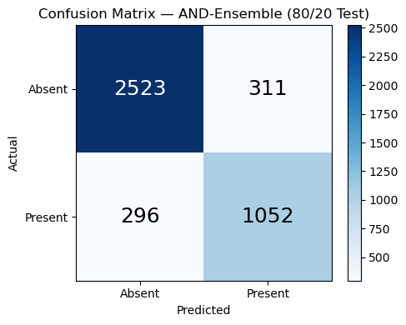
CHAPTER 6
Where the model is strong, and where it is not
Frequent formulaic categories are close to solved; the tail is not
Confusion matrix (Fig. 6.2)
The two ends of the distribution
Document Name 1.000, Parties 0.995, Governing Law 0.961 — but five categories with ≤7 test positives score 0.000. Micro-F1 0.776 against macro-F1 0.572.
Per-category F1, twelve strongest categories (Fig. 6.3)

Slide 12
PROBLEM 1
The presence model over-fires by design
Max-pooling turns 35 chances to be wrong into one document-level answer
0.562
0.908
11.0%
22.8%
precision at threshold 0.5
recall — it says yes to almost everything
of absent categories falsely flagged
of everything it flags is wrong
More data made it worse, not better
Six aggregation rules, none good enough
Training on all 53,662 windows moved recall 0.908 → 0.927 and precision 0.562 → 0.555. A better window scorer produces more spurious maxima.
Top-3 mean beats max at the default threshold; max wins given its own. No rule at any threshold reaches the baseline.
The honest caveat we must state
The 0.5 threshold was never chosen — it is the softmax default. Swept, the transformer reaches 0.750 instead of 0.694. Part of its deficit is an un-chosen operating point, not an inability to discriminate.

Slide 13
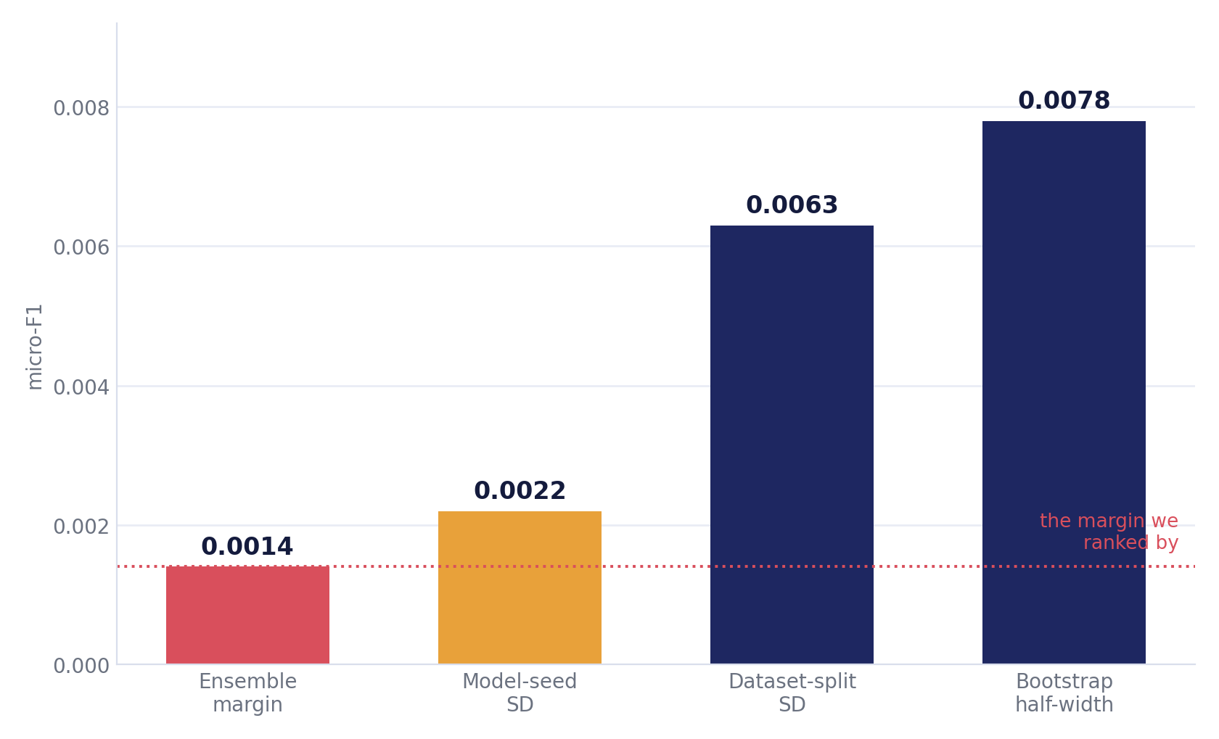
PROBLEM 2
We ranked a leaderboard by noise
The winning margin is smaller than every error bar we can measure
Every alternative explanation, tested
Undertrained? 53,662 windows → −0.0004
Unlucky seed? 3 seeds → gap is 9.5 SD
Wrong pooling? 6 rules → none reach baseline
Bad threshold? explains 0.056 — a real caveat
Reseeding alone
moves the ensemble by up to 0.0042 — three times the margin claimed for it. Seed choice alone would change which model we reported.

Slide 14
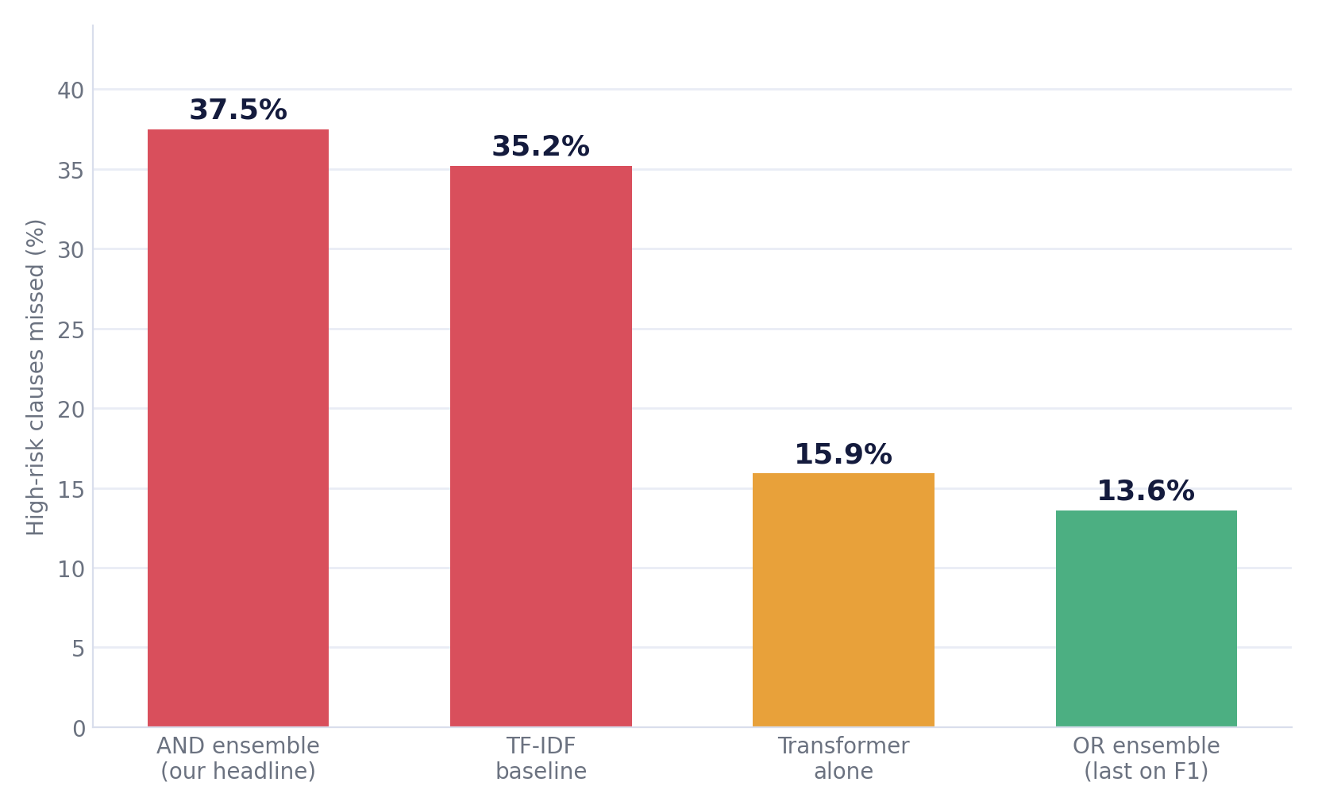
PROBLEM 3
The metric disagrees with the purpose
Percentage of HIGH-RISK clauses missed, by configuration
The configuration that wins on micro-F1 is the worst one for the clauses that matter most.
176 High-risk gold clauses
AND finds 110, loses 66
OR finds 152, loses 24
Cost of choosing on micro-F1: 42 High-risk clauses
Two thirds of micro-F1 is dates and party names
And on the rare tail
the AND rule adds nothing at all: F1 0.343 either way, with detections cut from 35 of 70 to 17 of 70.

Slide 15
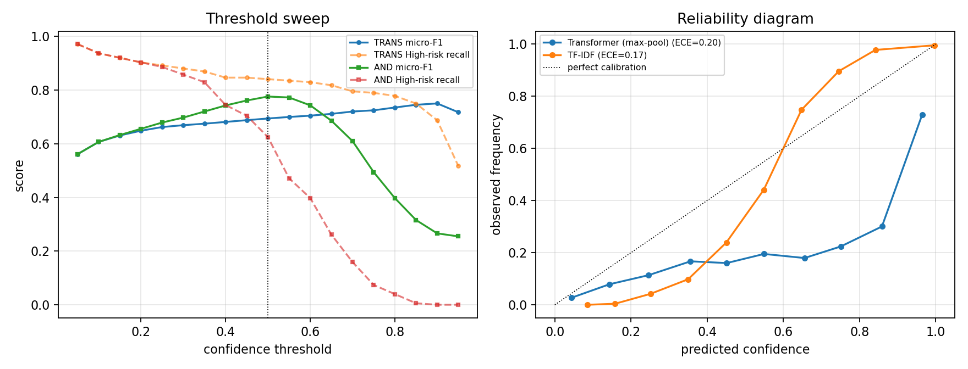
PROBLEM 3b
The threshold was never chosen, and the confidence means little
Both were measured only after the fact — and both turned out to matter
0.5 is the softmax default
Swept, the transformer reaches 0.750 instead of 0.694 — part of its deficit is an un-chosen operating point.
ECE 0.201
Scores above 0.9 mean the clause is present about 73% of the time. The app shows this as a confidence bar.
Threshold sweep and reliability diagram (Fig. 6.4)
We do not adopt the swept threshold: choosing it after seeing the test set is exactly the tuning the protocol certifies against. It stands as a diagnosis, and as an argument for carving a validation split next time.

Slide 16
PROBLEM 4
The span model is handed the wrong window — and answers anyway
Training taught it a layout that inference never provides
At training time
At inference time
answer
always ≈150 chars in — every single example
answer anywhere — or not in the window at all
31.7%
39.7%
0.763→0.386
0
the selected window has no clause in it
success even when the window IS right
token-F1, isolated → in the pipeline
ways to say “not here”
Max-pooling was trained to detect, not to locate — we reused a detector as a locator, and the span model has no abstention mechanism.

Slide 17
PROBLEM 5
The summarizer became a 41-way classifier
It never writes a sentence — it picks one
clause text
“any attempted assignment … will be void”
Anti-Assignment template
picked — correct 70%
FLAN-T5
learns to recognise
the CATEGORY
›
›
Cap on Liability template
ROFR template
picked — wrong 30%
⋮ 41 pre-written templates in total
0.775 → 0.116
0.115
100%
ROUGE-L: our templates → clause-specific references
score of the template with NO model at all
of outputs are a template, copied verbatim
Why this is worse than a low score
It cannot hallucinate — but when it picks the wrong template the output is fluent, confident, and about a different provision. Undetectable from the output alone.

Slide 18
PROBLEM 6
End to end, 78.3% of clauses are lost
The number that describes what a user actually experiences
1,348 gold clauses
↓ −296 clauses (22.0%)
1,052 survive presence detection
↓ −759 clauses (56.3%)
293 survive span extraction
21.7%
survive all three stages
95% CI [19.6%, 23.9%]
Multiplying the component scores predicts ≈64%. The pipeline delivers a third of it — which is why we measured this at all.

Slide 19
SUMMARY
Every problem we found, in one place
Six failures, five of which the component scores concealed
Presence
Ranking
1
Over-fires: precision 0.562. More data made it worse.
2
The +0.0014 winning margin is smaller than seed, split and bootstrap noise.
Risk alignment
Rare categories
3
The best model on micro-F1 misses 37.5% of High-risk clauses.
4
AND rule adds zero F1 on the 10 rarest; 5 categories score 0.000.
Span
Explanation
5
Wrong window 31.7% of the time; token-F1 0.763 → 0.386 in the pipeline.
6
Emits a template verbatim 100% of the time; 30% the wrong one.
Only one of these — over-firing — was visible from the component tables we started with.

Slide 20
FINDINGS
What we found
Four findings survived every check; five beliefs we started with did not
Findings that held
Beliefs that did not survive
Lexical evidence over the whole document beats windowed semantic evidence
“The ensemble beats the baseline”
+0.081, and it survives budget, seed, pooling and threshold controls
+0.0014 — smaller than bootstrap, seed and split noise alike
“The summarizer summarizes”
Measure a feasibility ceiling before training
0.775 → 0.116; a lookup table scores the same
a 60-second retrieval check (64%) killed an architecture at zero cost
“Component scores describe the system”
Agreement between models damps seed variance
≈64% predicted, 21.7% delivered
the ensemble is 4× less seed-sensitive than the transformer inside it
“A Longformer will not fit in memory”
it does, at batch 1 — 14.7 GB of 16. Time is the barrier, not memory
Span extraction genuinely works — given the right window
“Max-pooling is the ceiling”
token-F1 0.763, CI [0.740, 0.782]
six rules tested; it is a secondary factor, not the cause

Slide 21
LACKINGS FOUND
What we discovered was missing — in the data, the field, and our own setup
These were not known at the start; each was found by running the experiment
CUAD has no plain-English targets at all
So we wrote 41 ourselves — and that decision is precisely what collapsed the summarizer into a classifier. The dataset gap became the model's failure.
No published risk-severity model to build on
Legal NLP operationalizes importance as category membership, not danger to a party. We had nothing to validate our taxonomy against.
The rare tail is effectively few-shot
11–42 positive training contracts for the bottom ten categories. No model learns those at this dataset size; five score 0.000.
Some rare-tail “errors” are annotation disagreements
A clause labelled Third Party Beneficiary reads as an assignment clause. Our 0.000 scores mix model failure with label ceiling.
We never carved a validation split
So the threshold cannot be chosen and the confidence cannot be calibrated without redrawing the protocol. A structural gap, not an oversight in one experiment.
Nobody reports end-to-end survival
We had no published figure to compare our 21.7% against — which is also why the number was worth measuring.
Three of these six were only visible because we ran a control or an end-to-end test that the component protocol never asks for.

Slide 22
LACKINGS
What this work still lacks
Gaps in the evidence, not in the code — stated so an examiner does not have to find them
No expert validation of the risk taxonomy
41 levels written by three CS students. It is the main contribution over CUAD and the least evidenced part of the thesis.
No usability evaluation
Nobody outside the team has used Clausify. The claim that risk grouping helps a non-lawyer is untested.
One dataset, one jurisdiction
510 US contracts from SEC filings. No Bangladeshi contract, no consumer or employment agreement, no other language.
Nothing was tuned — in both directions
No test-set contamination, but the transformer competes untuned against a baseline with nothing to tune.
No faithfulness or readability metric
We report ROUGE and read outputs. No BERTScore, no entailment check, no human rating of legal meaning.
Span and summarizer are single runs
Only the presence model was reseeded and given a full-data control. The others carry unmeasured variance.
The first two are large enough that we would not present this as more than a prototype until they are closed.

Slide 23
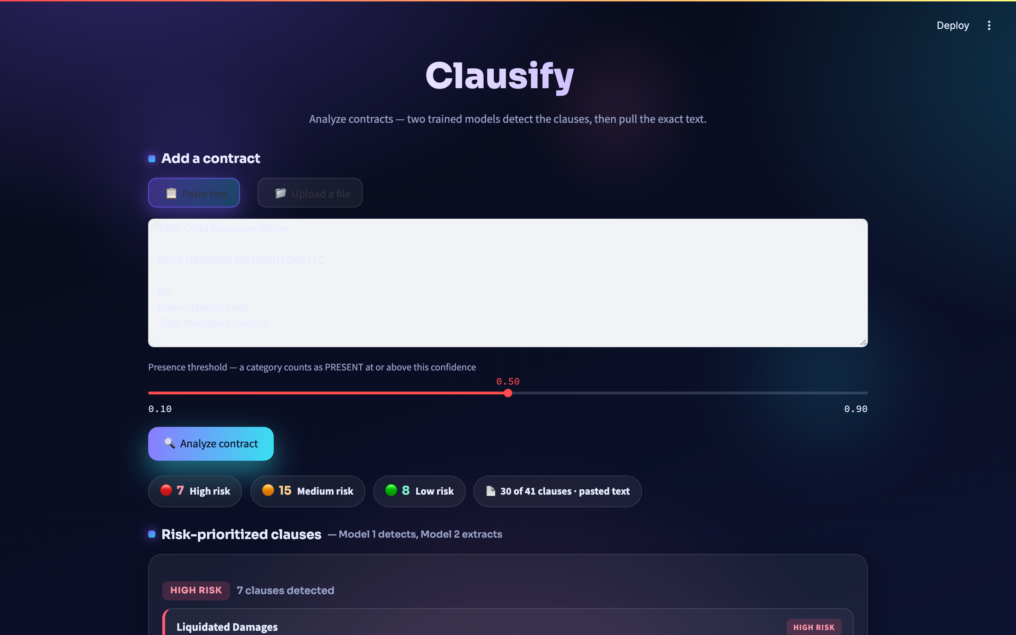
CHAPTER 7
Clausify — and three caveats it must carry
A prototype interface, with measured limits
Latency, measured
Confidence is not a probability
Long contracts are truncated
Median contract 27.1 s; worst case 32.4 s. The earlier “5–15 seconds” claim was an impression, not a measurement.
ECE 0.201. A nearly full bar (>0.9) means the clause is present about 73% of the time.
30-window cap = first 45,500 characters. 38.4% of CUAD contracts are longer.
Privacy holds — because it runs locally
The uploaded file is read into memory, never written to disk, never logged. That guarantee comes from running locally, not from anything the app does.
Read a card as “look here”, not “this is the clause”
The badge and category are far more reliable than the quoted sentence beneath them, which matches the real clause in about one case in five.
The risk-prioritized report Clausify produces (Fig. 7.2)

Slide 24
PROGRESS
How far we came
From a leaderboard number to a system we can describe honestly
P1
P2
Thesis
Thesis
Now
A baseline that
worked
A transformer that
did not beat it
Controls that
explained it
A pipeline measured
end to end
A prototype with
stated limits
›
›
›
›
TF–IDF + logistic
regression, 0.775
windowed DistilBERT
0.694 — and why
budget · seed · pooling
· threshold · split
21.7% survive — the
number users feel
Clausify + every
caveat written down
What exists at the end of it
3 trained models
11 experiments
presence, span, explanation — all reproducible from saved checkpoints
4 controls, rare tail, risk-weighted, threshold, calibration, ablation, end-to-end, cost benchmark
101 numbers verified
A deployed prototype
84 reported figures and 17 derived comparisons, checked mechanically against source data
Clausify, running locally, with every measured limitation stated in the interface

Slide 25
FUTURE WORK
Future work I — no compute required
The four highest-value things left, and none of them need a GPU
Get the taxonomy reviewed
Two law students, 30 minutes each. Report Cohen's κ and the disputed categories whatever they are. The sheet and scoring script are already written.
1
Observe someone using Clausify
5–10 participants. Watch specifically for over-trust in the quoted text and the confidence bar — both of which we have shown are unwarranted.
2
Select on the objective that matters
Define a risk-weighted criterion, choose the ensemble rule and thresholds on a validation split, then report once on test.
3
Calibrate the confidence score
Platt scaling or isotonic regression on a held-out split. Fixes ECE 0.201 with no retraining at all.
4
Ranked by value per hour. The top two are the gaps that keep this a prototype.

Slide 26
FUTURE WORK
Future work II — modelling
Each one targets a specific failure from the problems section
Give the span model a way to abstain
Train on the windows it will actually see
SQuAD v2-style unanswerable examples
Vary the answer offset instead of re-centring at 150 chars
fixes: confident answers from empty windows
fixes: token-F1 0.763 → 0.386 collapse
Locator trained for locating
Clause-diverse summarization targets
Replace the max-pool argmax with a model asked which window
Scale the 150-clause pilot to a few thousand references
fixes: 31.7% wrong-window rate
fixes: 100% template output
Attention pooling over windows
Cross-validation, not one split
A learned aggregator instead of a fixed statistic
Split SD 0.0063 is the largest uncertainty we measured
fixes: aggregation ceiling
fixes: single-split fragility

